Slide 1

v9 JavaScript Object Model Changes
DYNAMICS 365

Slide 2

Mitch Milam
mitch@xrmcoaches.com
@mitchmilam
linkedin.com/in/mitchmilam
youtube.com/xRMCoaches

Slide 3
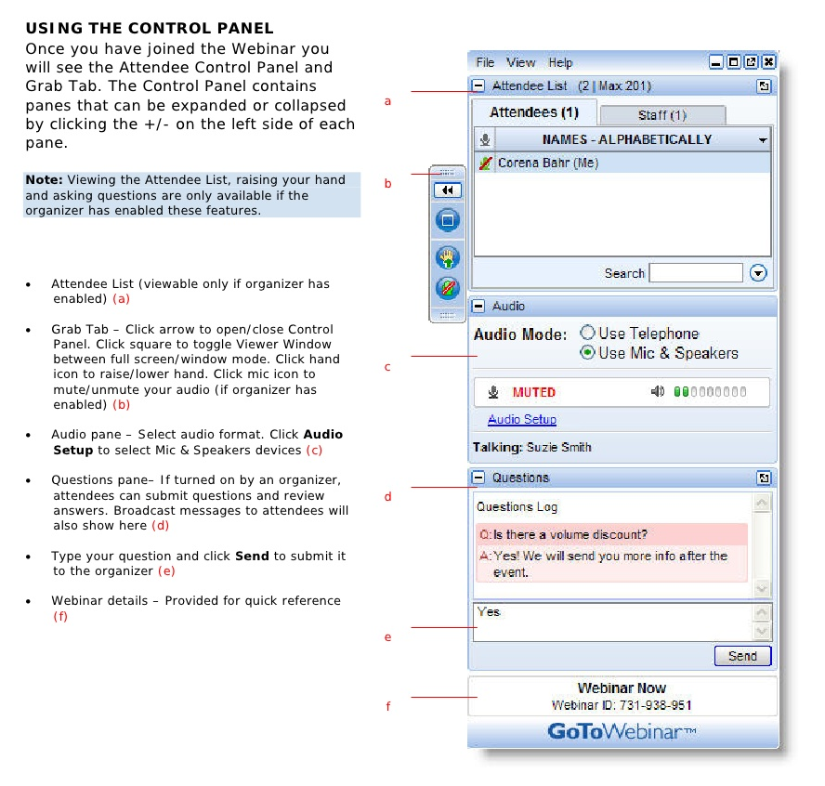
Webinar Housekeeping

Slide 4
Announcements
The new object model will be added to my Dynamics 365 JavaScript Development course
learn.xrmcoaches.com

Slide 5
Agenda
Depricated Client APIs
New Client APIs
What does it all mean?
Q&A

Slide 6
Before We Begin

Slide 7


Slide 8
Deprecated
Client APIs

Slide 9
Xrm.Page.context
Deprecated API | Replacement API
Xrm.Page.context.getTimeZoneOffsetMinutes | globalContext.userSettings.getTimeZoneOffsetMinutes
Xrm.Page.context.getUserId | globalContext.userSettings.userId
Xrm.Page.context.getUserLcid | globalContext.userSetings.languageId
Xrm.Page.context.getUserName | globalContext.userSettings.userName
Xrm.Page.context.getUserRoles | globalContext.userSettings.securityRoles
Xrm.Page.context.getIsAutoSaveEnabled | globalContext.organizationSettings.isAutoSaveEnabled
Xrm.Page.context.getOrgLcid | globalContext.organizationSettings.languageId
Xrm.Page.context.getOrgUniqueName | globalContext.organizationSettings.uniqueName

Slide 10
Grid Methods
Deprecated API | Replacement API
GridRow.getData | GridRow.data
GridRowData.getEntity | GridRowData.entity

Slide 11
Xrm.Utility changes
Deprecated Method | New method to be used
alertDialog | Xrm.Navigation.openAlertDialog
confirmDialog | Xrm.Navigation.openConfirmDialog
getBarcodeValue | Xrm.Device.getBarcodeValue
getCurrentPosition | Xrm.Device.getCurrentPosition
openEntityForm | Xrm.Navigation.openForm
openQuickCreate | Xrm.Navigation.openForm
openWebResource | Xrm.Navigation.openWebResource

Slide 12
Xrm.Mobile.offline
Deprecated API | Replacement API
Xrm.Mobile.offline | Xrm.WebApi.offline

Slide 13
Parent.Xrm
Was:
An HTML web resource may interact with the Xrm.Page or Xrm.Utility objects within the form by using parent.Xrm.Page or parent.Xrm.Utility.
Now:
parent.Xrm.* will work if the HTML web resource is loaded in a form container. For other places, such as loading an HTML web resource as part of the SiteMap, parent.Xrm.* won’t work.

Slide 14
Custom Controls Anyone?
Deprecated API | Replacement API
addOnKeyPress | Use a custom control
removeOnKeyPress | Use a custom control
showAutoComplete | Use a custom control and corresponding UI
hideAutoComplete | Use a custom control and corresponding UI

Slide 15
New and Changed
Client APIs

Slide 16
Global Context
Contains information about the environment
Was:
Xrm.Page.context
Now:
Xrm.Utility.getGlobalContext

Slide 17
New Client APIs
New Namespace | Description
Xrm.Device | Provides methods to use native device capabilities of mobile devices.
Xrm.Encoding | Provides methods to encode strings.
Xrm.Navigation | Provides navigation-related methods.
Xrm.WebApi | Provides properties and methods to use Web API to create and manage records and execute Web API actions and functions.

Slide 18
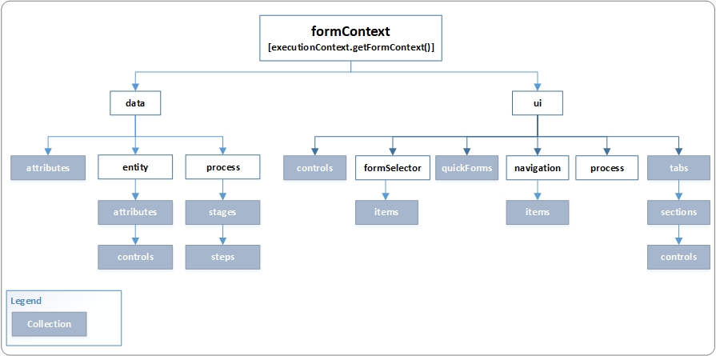
formContext

Slide 19
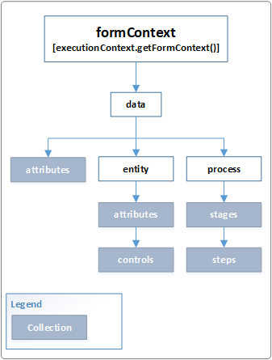
formContext.data

Slide 20
formContext.data.entity
New methods
getEntityReference
isValid

Slide 21
formContext.data.entity attribute
New methods
isValid
setPrecision

Slide 22
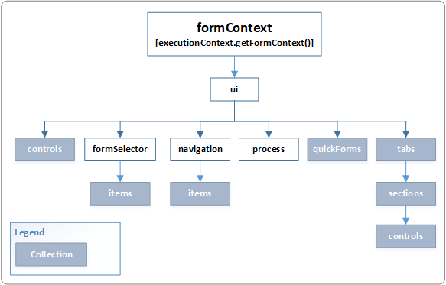
formContext.ui

Slide 23
What does this all mean?

Slide 24
Change #1: Use formContext instead of Xrm.Page
// Current (< Dynamics 365)
function displayName() {
var firstName = Xrm.Page.getAttribute("firstname").getValue();
var lastName = Xrm.Page.getAttribute("lastname").getValue();
console.log(firstName + " " + lastName);
}
// New (>= v9)
function displayName(executionContext) {
var formContext = executionContext.getFormContext(); // get formContext
formContext.getAttribute("firstname").addOnChange(firstName_onChange);
// use formContext instead of Xrm.Page
var firstName = formContext.getAttribute("firstname").getValue();
var lastName = formContext.getAttribute("lastname").getValue();
console.log(firstName + " " + lastName);
}

Slide 25
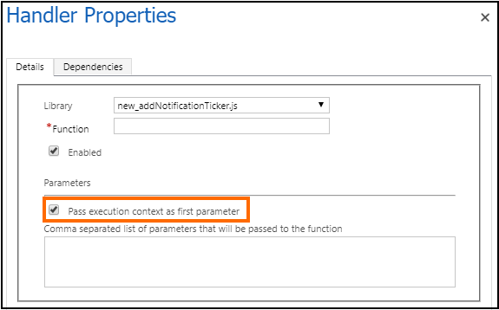
Change #1

Slide 26
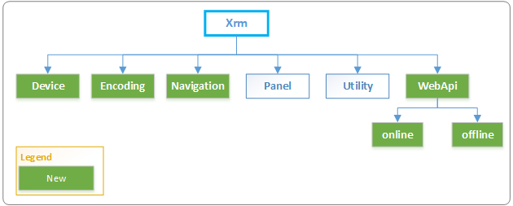
Change #2: New Xrm Object

Slide 27
Change #3: Enjoy the new stuff
Xrm.WebApi
Method | Description
createRecord | Creates an entity record.
deleteRecord | Deletes an entity record.
isAvailableOffline | Returns a boolean value indicating whether an entity is offline enabled.
retrieveRecord | Retrieves an entity record.
retrieveMultipleRecords | Retrieves a collection of entity records.
execute | Execute a single action, function, or CRUD operation.
executeMultiple | Execute a collection of action, function, or CRUD operations.

Slide 28
Change #3
Xrm.Navigation
Method | Description
openAlertDialog | Displays an alert dialog containing a message and a button.
openConfirmDialog | Displays a confirmation dialog box containing a message and two buttons.
openErrorDialog | Displays an error dialog.
openFile | Opens a file.
openForm | Opens an entity form or a quick create form.
openUrl | Opens a URL, including file URLs.
openWebResource | Opens an HTML web resource.

Slide 29
Change #3
Xrm.Device
Method | Description
captureAudio | Invokes the device microphone to record audio.
captureImage | Invokes the device camera to capture an image.
captureVideo | Invokes the device camera to record video.
getBarcodeValue | Invokes the device camera to scan the barcode information, such as a product number.
getCurrentPosition | Returns the current location using the device geolocation capability.
pickFile | Opens a dialog box to select files from your computer (web client) or mobile device (mobile clients).

Slide 30
Change #4: Object Model Maturity
Xrm.Utility.lookupObjects(lookupOptions).then(successCallback, cancelCallback)
Xrm.Navigation.openAlertDialog(alertStrings, alertOptions).then(closeCallback, errorCallback);
Xrm.Navigation.openForm(entityFormOptions, formParameters).then(successCallback, errorCallback);

Slide 31
Questions?

Slide 32
Thank You

